Slide 1
Software Testing Project
Testing Numpy
Group 22
Aliaksandra Kupreyeva,
Anton Gildebrand,
Egemen Yiğit Kömürcü,
Sotirios Chatzigeorgiou,
Tshering Gyeltshen

Slide 2
OUTLINE
Project Description
Black Box Testing
White Box Testing
Conclusion
Future Work

Slide 3
Numpy
NumPy is the fundamental package for scientific computing with Python. It contains among other things:
a powerful N-dimensional array object
sophisticated (broadcasting) functions
tools for integrating C/C++ and Fortran code
useful linear algebra, Fourier transform, and random number capabilities

Slide 4
BLACK BOX TESTING
Searching: argmax, argmin, where
Linear Algebra: det, dot, norm
Ndarray: dtype, shape, indexing
Sorting: heap, quick, merge, stable
Statistics: median, average, std, var
For example:
The det function of the Linear Algebra submodule takes a matrix and returns it’s determinant
The median function of the Statistics submodule takes an array and returns the median value of that array
The shape function of the Ndarray submodule returns the dimensions of a matrix

Slide 5
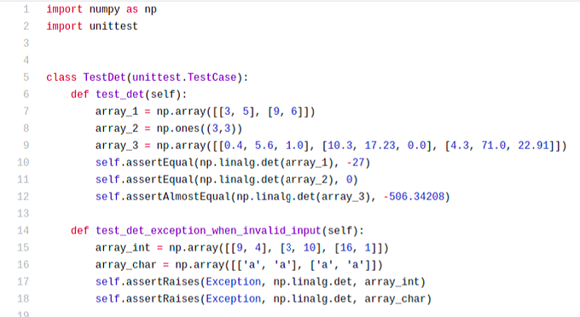
TEST CASES

Slide 6
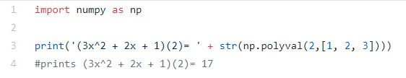

WHITE BOX TESTING
We are testing the polynomial submodule which provides functions for dealing with polynomial series
One function in the polynomial submodule is the polyval function, which evaluates a polynomial for a given value of x:
Interesting piece of code found in the implementation of polyval:

Slide 7
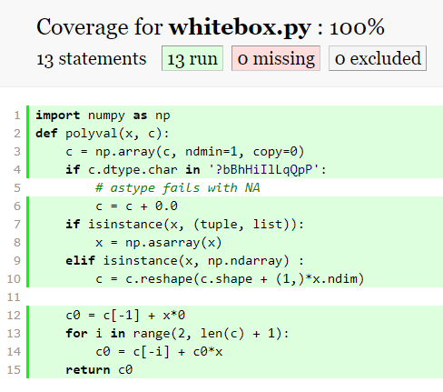
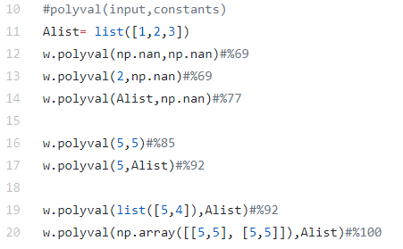
TEST CASES

Slide 8
CONCLUSION
NumPy: Explore the capabilities of NumPy through software testing
Black box testing: Opportunity to expand our knowledge of Unit testing framework
White box testing: Opportunity to deal with Coverage API

Slide 9
FUTURE WORK
Implement white box testing:
Polyval function with expansion of other polyval related functions
A more complicated function
Construct a control flow graph using methods of the white box testing field

Slide 10
REFERENCE
[1] N. developers, "NumPy," 2019. [Online]. Available: https://numpy.org/. [Accessed 4 November 2019].

Slide 11
THANK YOU FOR LISTENING
Any questions?

